Slide 1
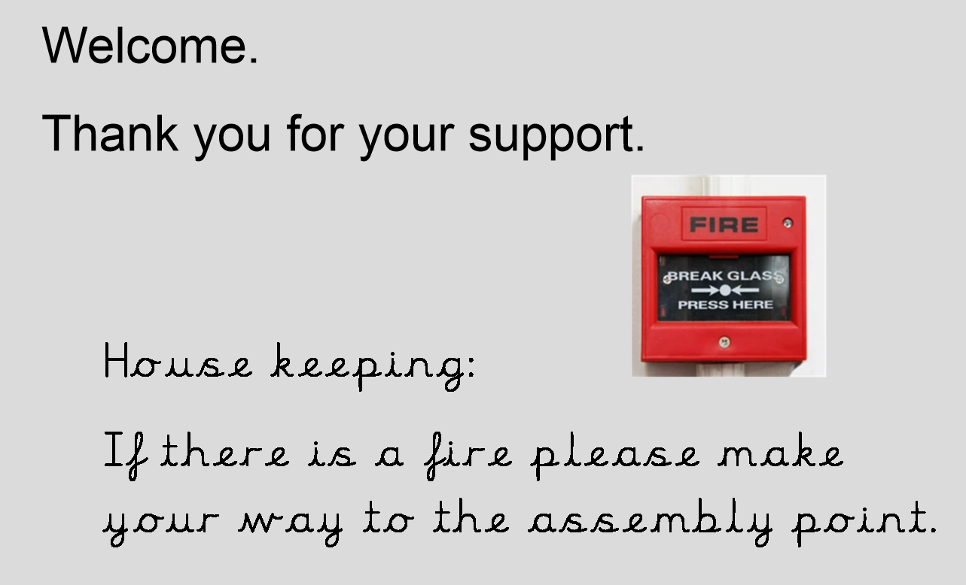

Slide 2
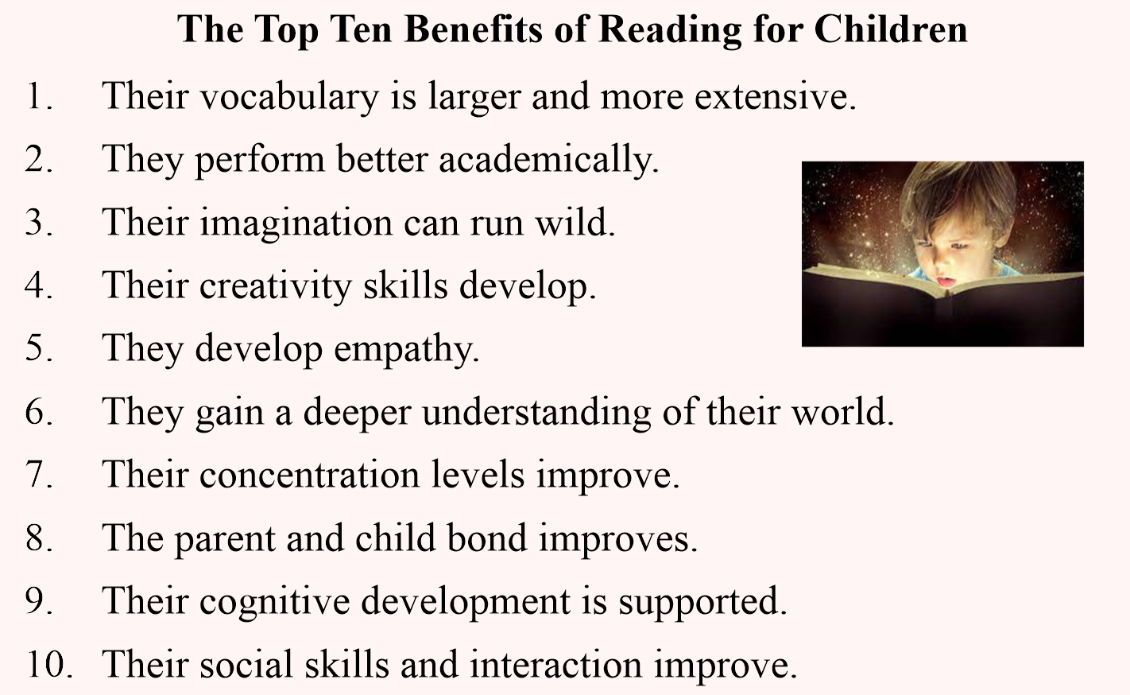

Slide 3
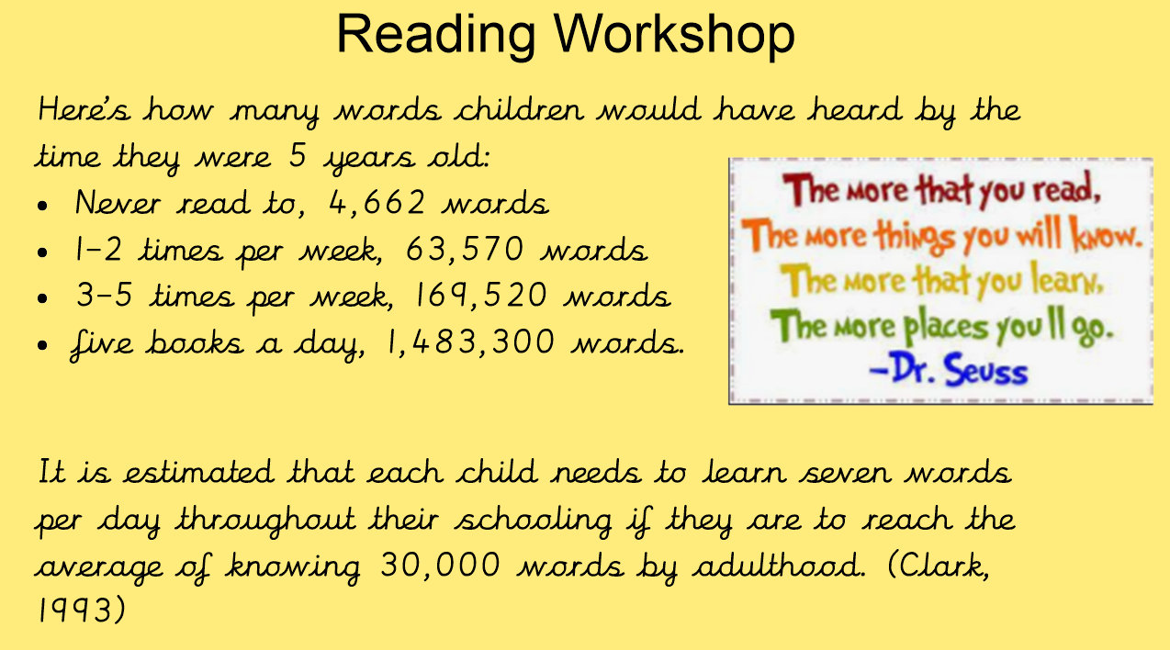

Slide 4
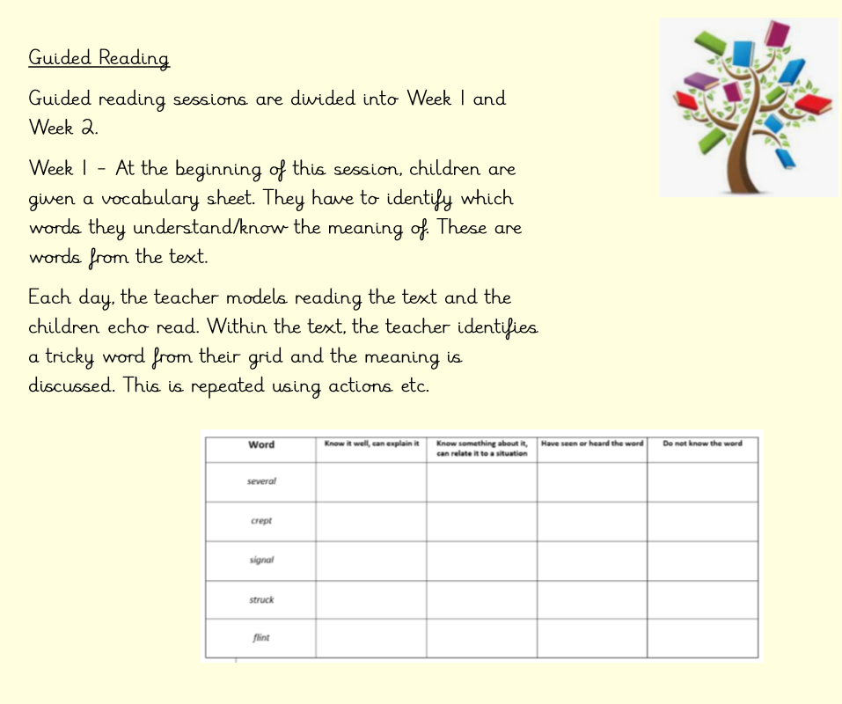

Slide 5
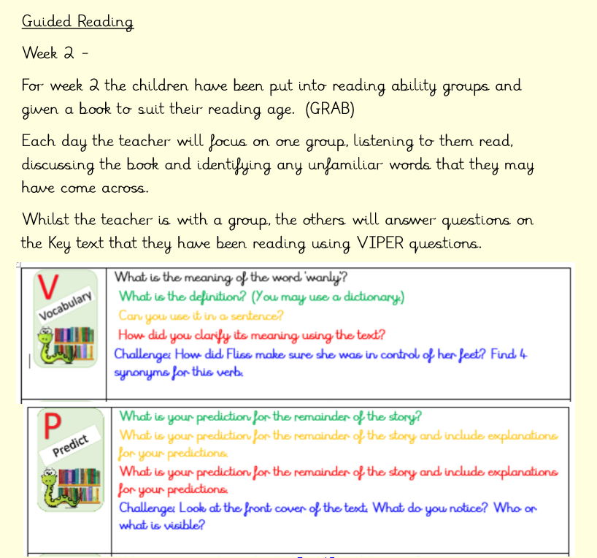

Slide 6
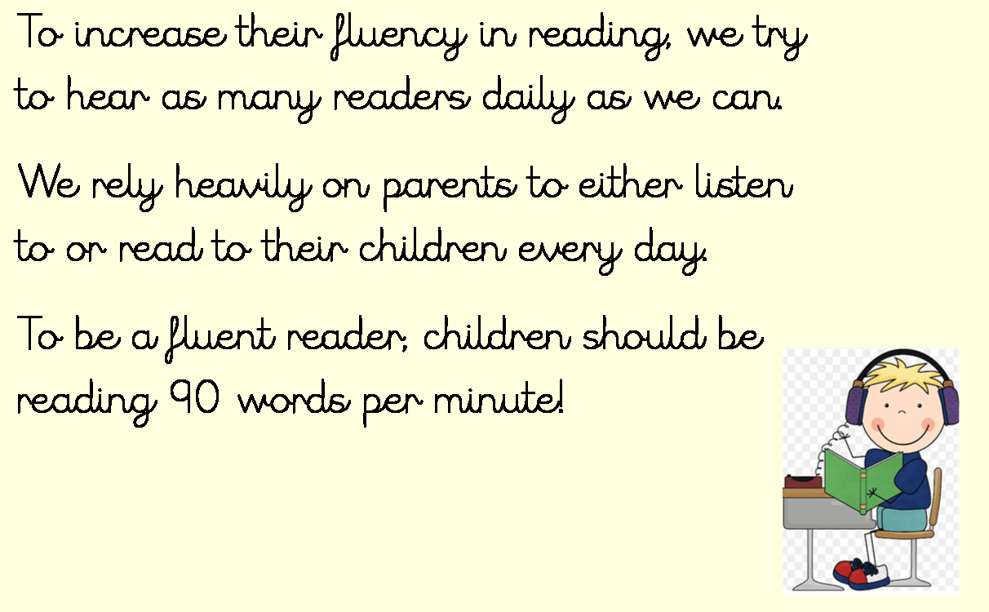

Slide 7
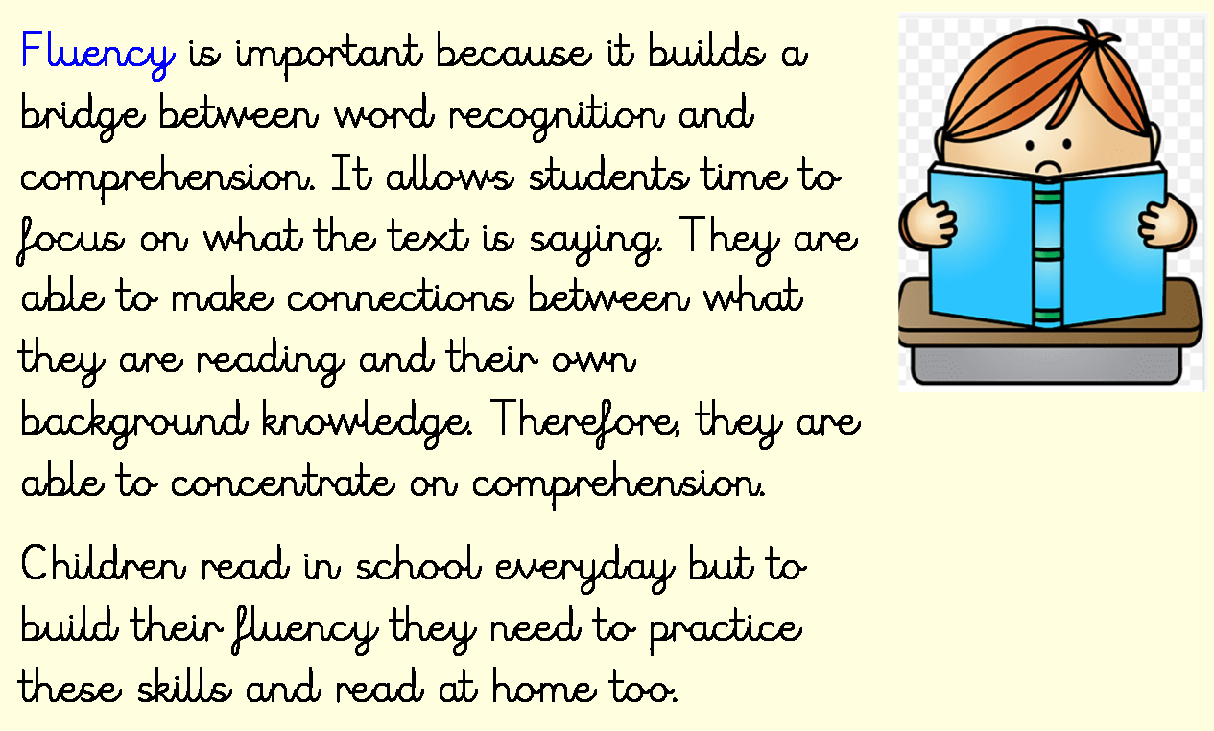

Slide 8
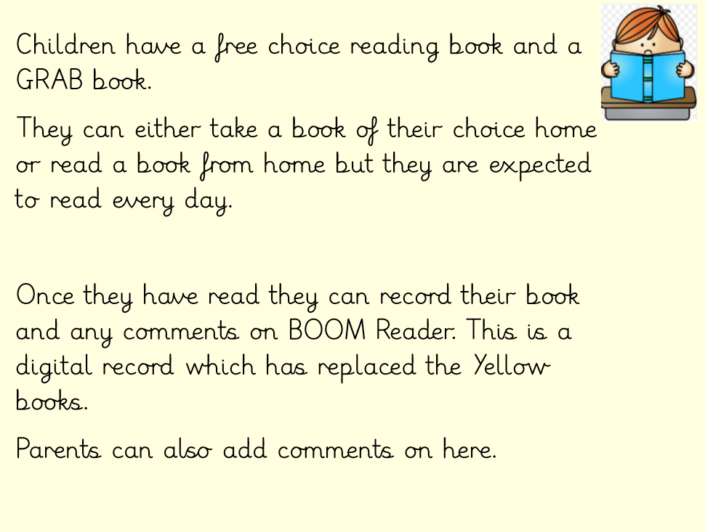

Slide 9
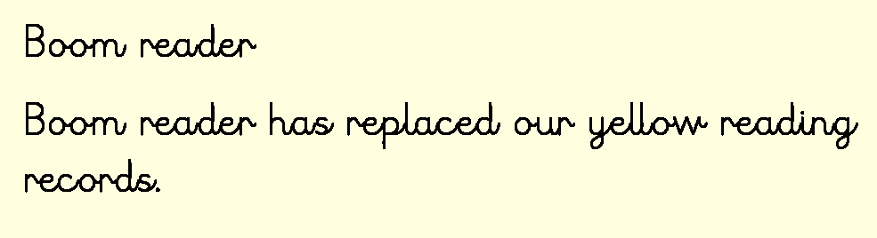
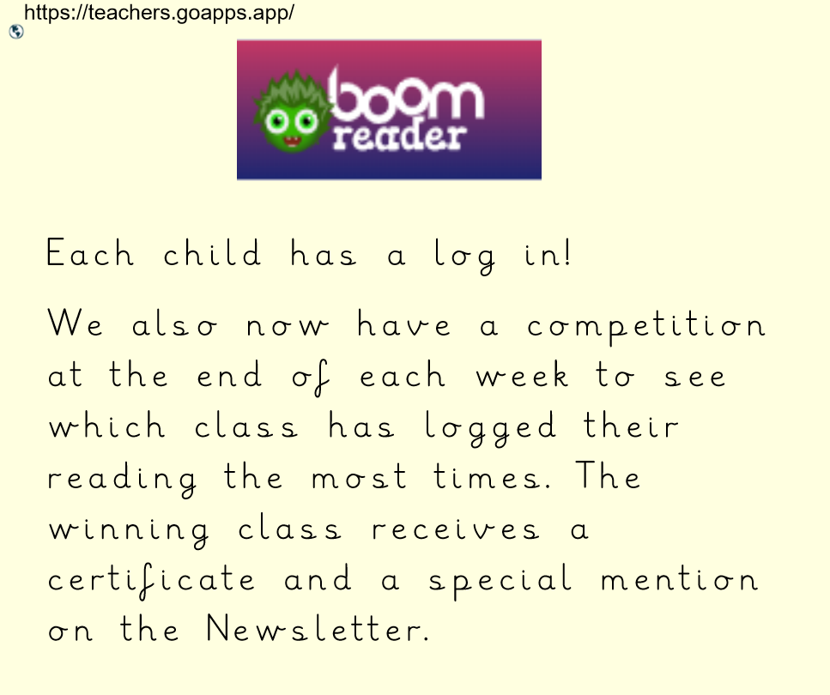

Slide 10


Introduction
BoomReader is the new way we are logging home and school reading.
It has been used by hundreds of schools and thousands of parents, children and teachers since 2020.

Slide 11
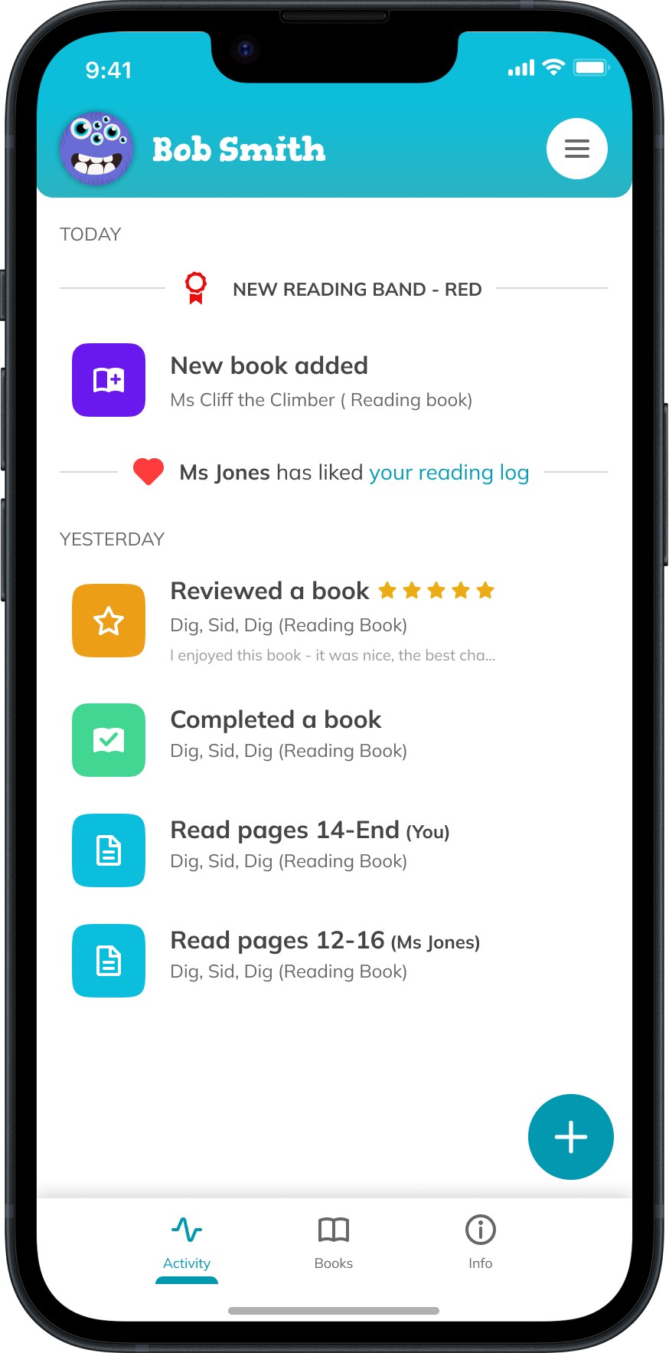
Benefits
No more lost paper reading diaries!
No more damaged paper reading
diaries- the ‘water bottle leaked in the bag’ diaries are gone forever!
All reading you log will be saved for the entire time your child is in school so no logs are lost.
Only one parent account needed for your family

Slide 12
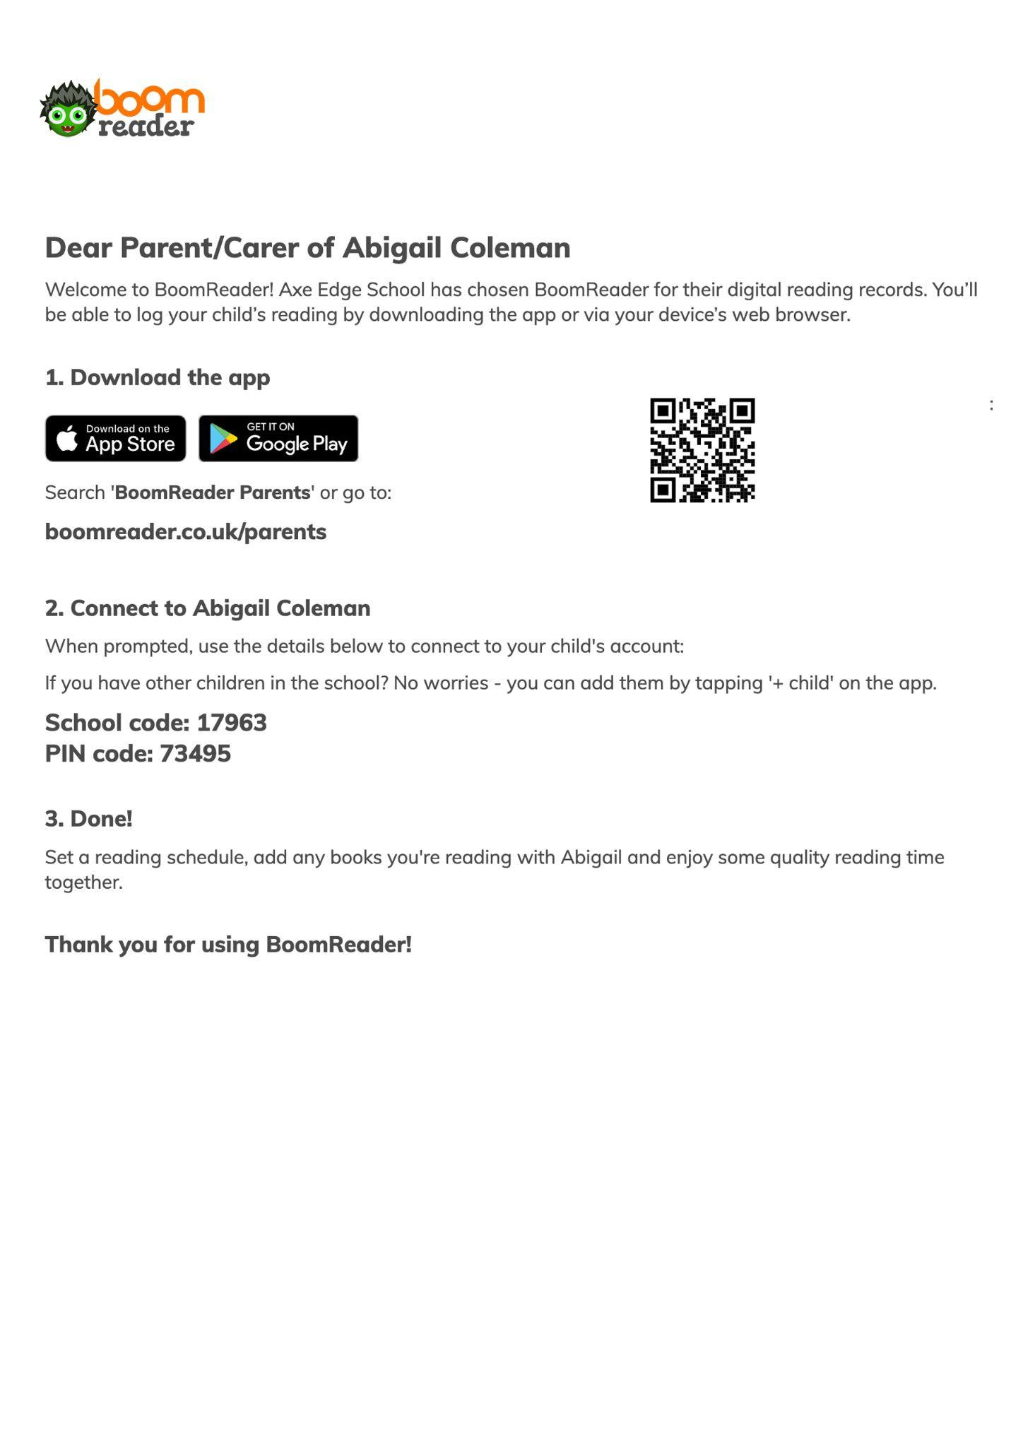
Getting started
Please use the login details letter sent home by your child’s teacher
Follow the instructions to download the app
Create an account quickly and easily
Connect to your child (with the school code/login code on the letter)
That’s it - you’re all set!
Please use the one page guide for help as needed.

Slide 13

Guide
Activity
You can view and tap
on any activity here to see more detail, add logs etc.

Slide 14
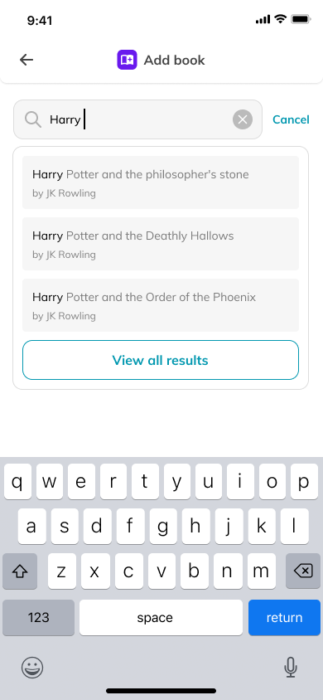
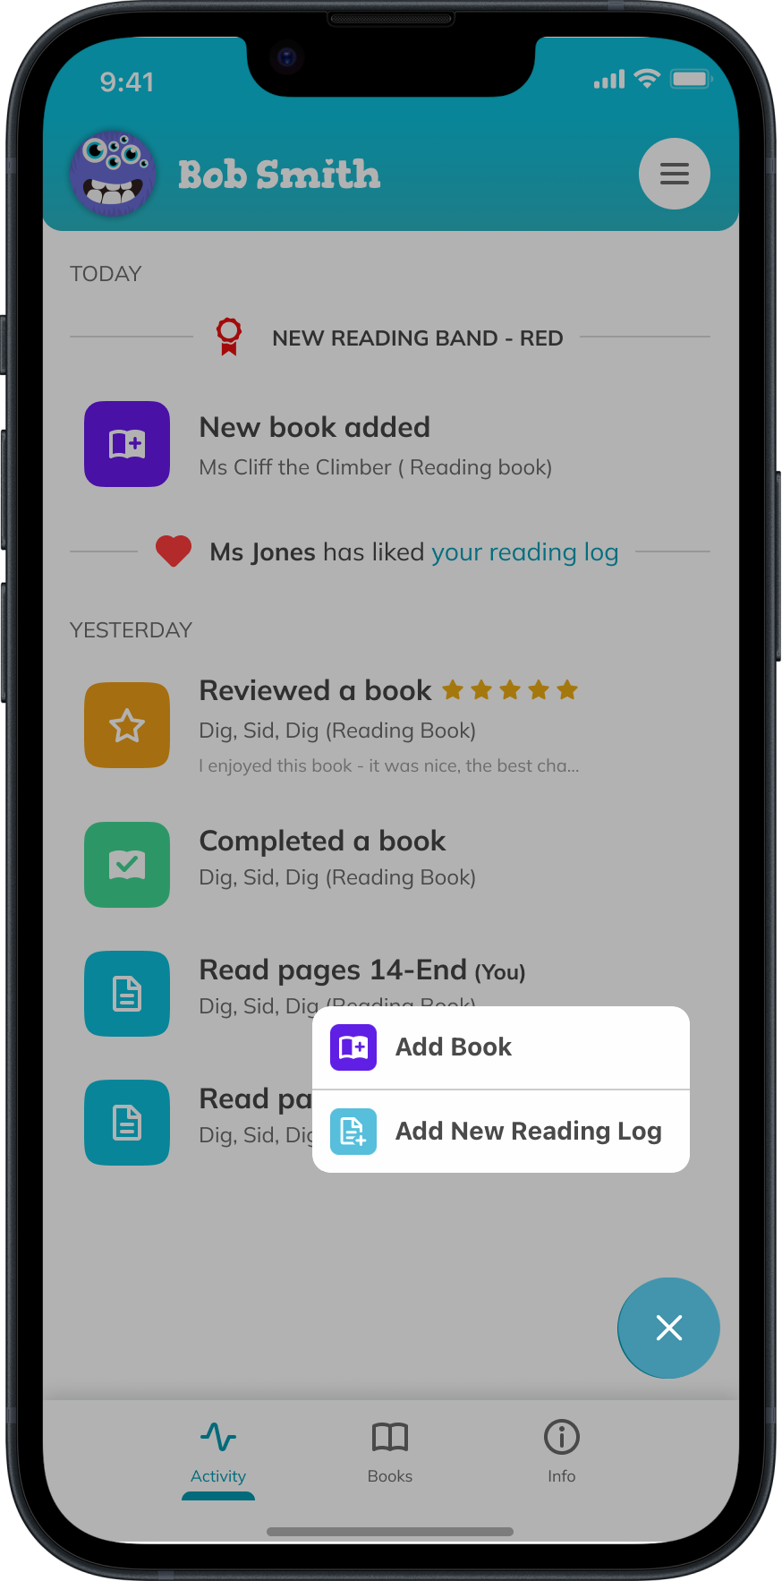

Guide
Add Book
Simply start typing the book title to find your book. You can also add the book title yourself.

Slide 15
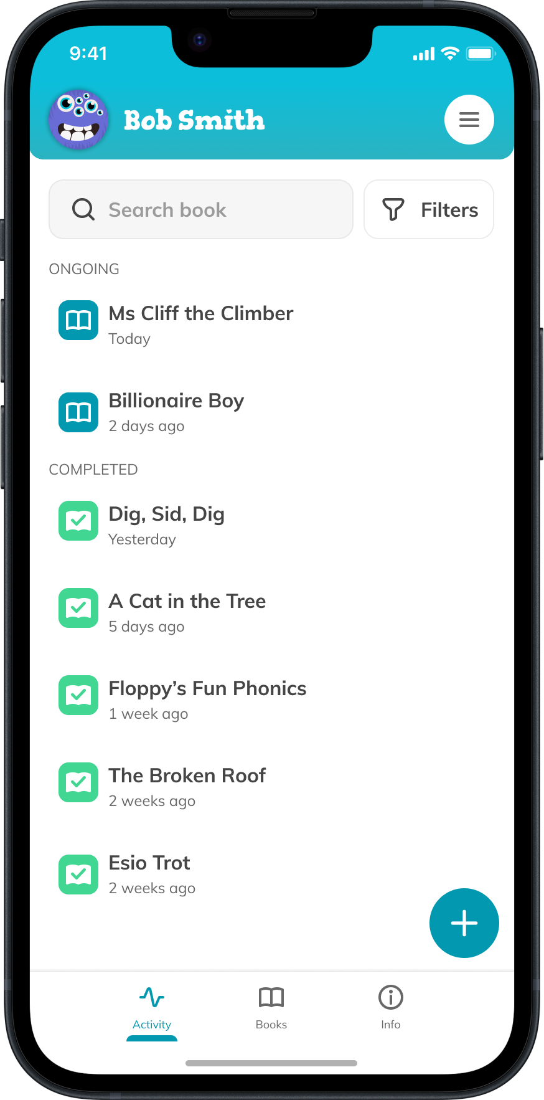
Guide
Books
All current and completed books are listed here.
Tap a book to view the reading history.

Slide 16
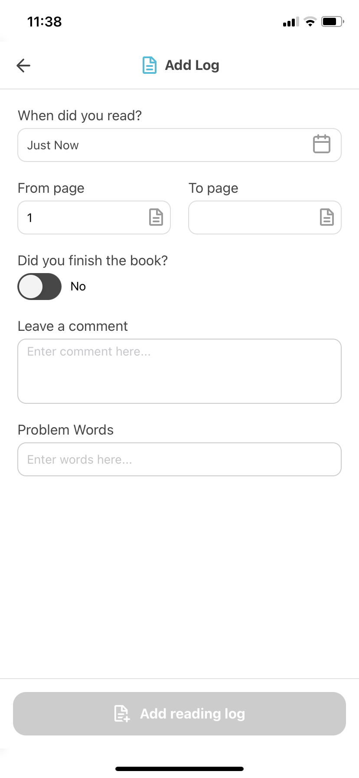
Guide
Add Reading Log
Choose the book and then fill in the log. Minimum requirement is the page number your child read to.
Tap edit log to make make
any changes.

Slide 17


