Slide 1
Phonic Screening Check
A Guide for Parents

Slide 2

What is phonics?
Children begin to learn phonics in the Early Years (Nursery and Reception). Children start by learning that individual letters make sounds. As they progress through Reception and into Year 1, they will begin to blend the sounds in words to read. By the end of Year 2, children will typically be able to read a wide variety of texts with fluency and expression.

Slide 3

We use the programme ‘Read Write Inc’ to help us to teach your child to read. Typically from Reception to Year 2, your child will progress through the programme. We are now using the coloured ‘Read Write Inc’ books within our phonics lessons and your child will progress through the colours.

Slide 4
What does phonics look like at school?
Every child takes part in a 45 minute phonics session every day. This session runs from 9:05-9:50am. It is vital that your child is at school on time so that they don’t miss out on key reading skills. The phonics groups are carefully planned so that your child is learning from exactly where they need.
In a phonics lesson, children will learn a new sound or they will rehearse and re-cap a sound that they have previously learnt. They will practise their spelling by writing words containing sounds they have learnt so far. They will also develop their reading and comprehension skills through reading key texts that are selected to perfectly match your child’s reading ability.

Slide 5
Phonic Screening Check
Children in Year 1 throughout the country will all be taking part in a phonics screening check during the same week in June. This year it is during the week commencing 6th June. Children in Year 2 will also take the check if they did not achieve the required result when in Year 1 or they have not taken the test before.
Headteachers should decide whether it is appropriate for each of their pupils to take the phonics screening check. The phonics screening check is designed to confirm whether individual children have learnt phonic decoding and blending skills to an appropriate standard.

Slide 6
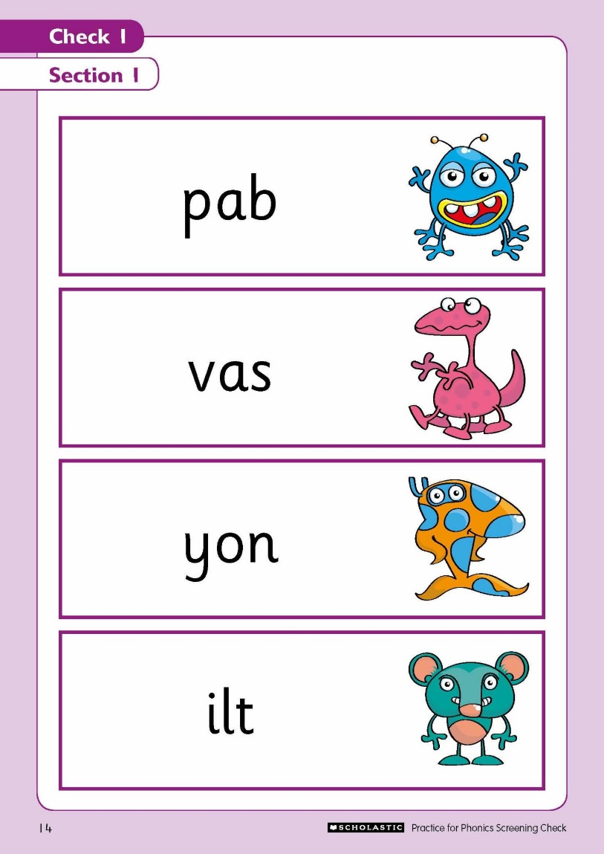
What happens in the check?
The check contains 40 words. Each child will sit one-to-one and read each word aloud to a teacher. The test will take approximately 10 minutes per child, although all children are different and will complete the check at their own pace. The list of words the children read is a combination of 20 real words and 20 alien words (made up words).

Slide 7
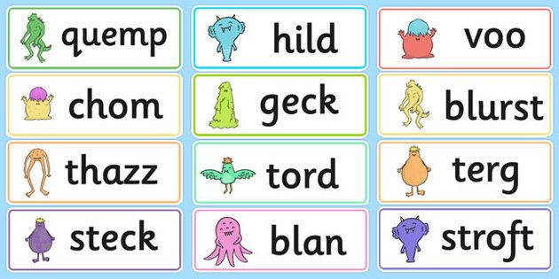
Alien Words
The alien words will be shown to your child with a picture of an alien. This provides the children with a context for the alien word which is independent from any existing vocabulary they may have. Alien words are included because they will be new to all pupils; they do not favour children with a good vocabulary knowledge or visual memory of words.
Some schools may call alien words ‘pseudo words’ or ‘nonsense words’. The children will be familiar with reading alien words in their daily phonics lesson.

Slide 8
Year 1 phonics screening check training video - Bing video
Children are not given any support to read the words in the check; however the following guidance is accepted:
Children self-correcting
Children sounding out each letter before reading the word
Children reading the words without sounding out each letter
Children reading the words in their accent
Children’s typical speech is also considered

Slide 9
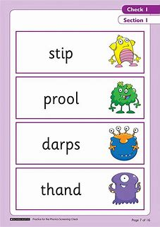
Take a look…
On your table, you will find some examples of previous year’s checks.

Slide 10
Reporting to Parents
By the end of the summer term, all schools must report each child's results to their parents. They will also confirm if the child has met the standard threshold. Children who do not achieve the expected level will retake the test when they are in Year 2.
The typical pass mark for the check is 32 out of 40; however you will just be informed as to whether your child has met or has not met the standard threshold.

Slide 11
How will the results be used?
Schools will use the results of the Phonic Screening Check to identify which children need extra support with their reading in Year 2.
Schools will also use the data to analyse their own performance and Ofsted will use this information in inspections.

Slide 12
How will we help to prepare your child at school?
Your child will take part in the Phonic Screening Check with a familiar adult.
The check is completed very similarly to how we do our own half termly phonics assessments. Your child will not realise that they are taking part in a ‘test’.
Every child has taken part in a mock check already so they are familiar with the format.
We will continue with our daily phonics lessons, as well as a fast paced 10 minute session in the afternoon.
Children who we have identified as needing extra support will be invited to attend a ‘Reading Club’ run in Summer term by Miss Kelly.
Children who we have identified as needing extra support will also read more frequently with a familiar adult at school through a daily intervention.

Slide 13
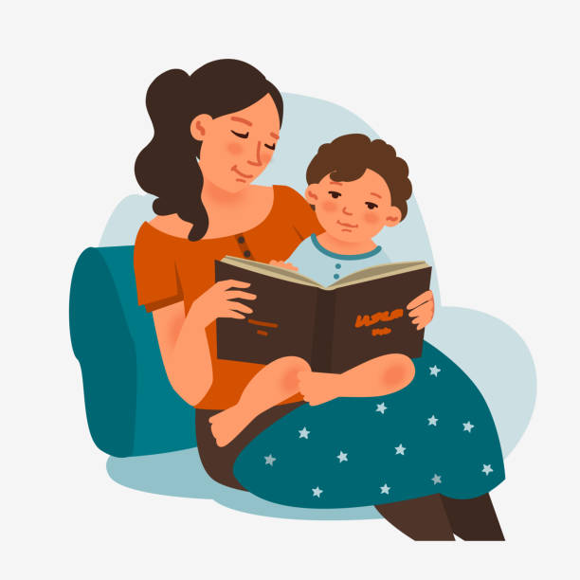
How can you help your child at home?
Support your child daily to read the reading books they bring home from school. Keep this short and snappy (10 minutes a day is plenty!)
Practise identifying the set 2 and set 3 sounds at speed
Play a variety of phonics games at home
Encourage and praise your child with their reading!
Encourage your child to ‘spot the special friend’ and ‘Fred talk the word’.

Slide 14
Any questions?
Thank you for coming ☺

