Slide 1
The Early Years Foundation Stage (EYFS) Framework
2021

Slide 2
What to expect in the Early Years Foundation Stage (EYFS)
The Early Years Foundation Stage (EYFS) outlines what adults must do to help children learn and develop and to be healthy and safe.
The EYFS includes seven areas of learning and development. These are split into three age bands:
Birth to three
3-4 years old
Reception aged children

Slide 3
Seven areas of learning and development in the EYFS
The three prime areas are crucial for igniting children’s curiosity and enthusiasm for learning.
Communication and Language
Personal, Social and Emotional Development
Physical Development
The three prime areas are strengthened and applied through the four specific areas.
Literacy
Mathematics
Understanding the World
Expressive Arts and Design

Slide 4
Understanding your child’s development
Children develop and learn at different rates and in different ways.
Sometimes children have some early difficulties in their development. With the right help, they can quickly grow out of these difficulties.
Some children have long term difficulties. It is important to identify what their needs are and make sure they get the support they need.
Every child can make good progress, with the right support.

Slide 5
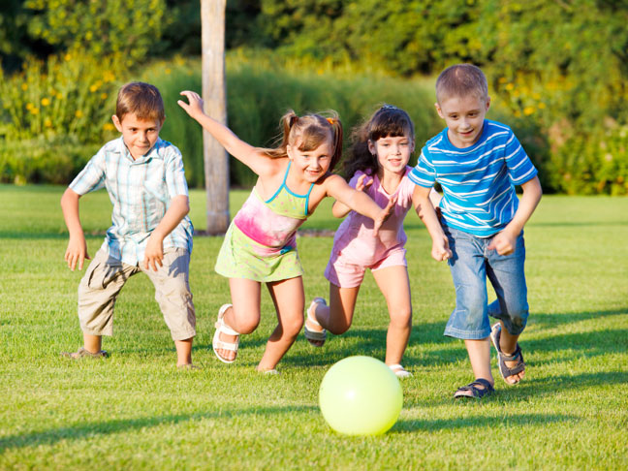

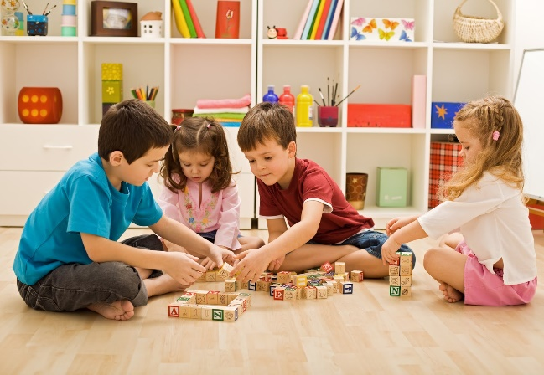
How will my child learn?
The EYFS framework identifies the essential role of play in your child’s development. It is through both child-led play and play guided by an adult that your child will develop confidence and relationships with others.
Some learning will be through adult led sessions such as phonics and other learning will be through play based opportunities independently and with the support or guidance of an adult.

Slide 6
How will I know how my child is doing at school?
Our Early Years team use their professional knowledge to understand your child’s level of development. If we have any concerns about your child’s progress, we will discuss these with you.
Two formal assessments will take place during Reception:
The Reception Baseline Assessment (at the start of the Reception year)
The Early Years Foundation Stage Profile (at the end of Reception)

Slide 7
Discussions at our Termly Learning Conferences (TLCs) will inform you about how your child is progressing. At the end of the academic year, a report will be given to you to inform you of your child’s progress and whether they have met or are continuing to work towards the Early Learning Goals (ELGs). There are 17 ELGs your child is expected to achieve by the end of Reception.
The first TLC will be during the week of 1st November. This will be a conversation on the phone with your child’s class teacher. You will receive more information about the TLCs this week, including a time to sign up.

Slide 8

We will also share your child’s learning through the website and app Class Dojo. This will be by our Early Years staff sharing photos of learning and activities, setting weekly home learning activities or by sharing your child’s personal achievements through photos or comments via your child’s portfolio on Class Dojo.
If you have not signed up to Class Dojo yet, please contact your child’s class teacher.

Slide 9
Changes to the Early Years Foundation Stage Framework
The Early Years Foundation Stage (EYFS) has been reformed and there is a new framework that all schools and settings are required to follow from September 2021. These national changes have been made to better support all pupils’ learning and development. It is also the aim that the new framework will better prepare pupils for the transition into Key Stage 1.
If you have had children in EYFS previously, you may notice some elements that have changed this year.

Slide 10
Early Years staff will be spending less time on large amounts of written observations and assessments for evidence collection. This means that they can spend more time supporting and engaging with the children and their learning and development needs. We will be sharing ‘wow’ moments with parents verbally or via Class Dojo but this may mean you will see less observations for your child than in previous years.
Pupils will no longer be assessed against statements from an age band category. Instead, staff will use their experience and knowledge to monitor if a child’s learning and development is on track for their age.
The Early Learning Goals (ELGs) at the end of Reception have been changed to become more clear and easier to understand. Staff will use their judgements to assess if pupils have met these goals at the end of Reception and will inform parents/carers.

Slide 11
There is an emphasis on improving pupils’ language and vocabulary. We will be introducing vocabulary through the programme ‘Word Aware’ and also through stories, activities and through play.
Literacy and numeracy skills focussed on in the EYFS have been adapted to better match up with the National Curriculum that starts in year 1.
There is no longer an exceeding judgement at the end of Reception. Pupils will instead be challenged to have a greater depth and understanding of ideas.
Safeguarding and welfare of pupils is still of upmost priority, with the added mention of teaching pupils about the importance of good oral health and how to keep teeth clean and healthy.

Slide 12

Thank you for coming

